Slide 1
GW_Chart

Slide 2
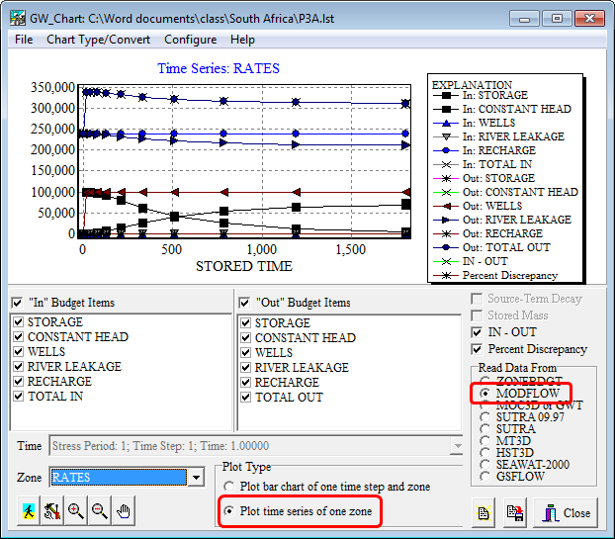
Plot Water Budget Data vs. Time

Slide 3
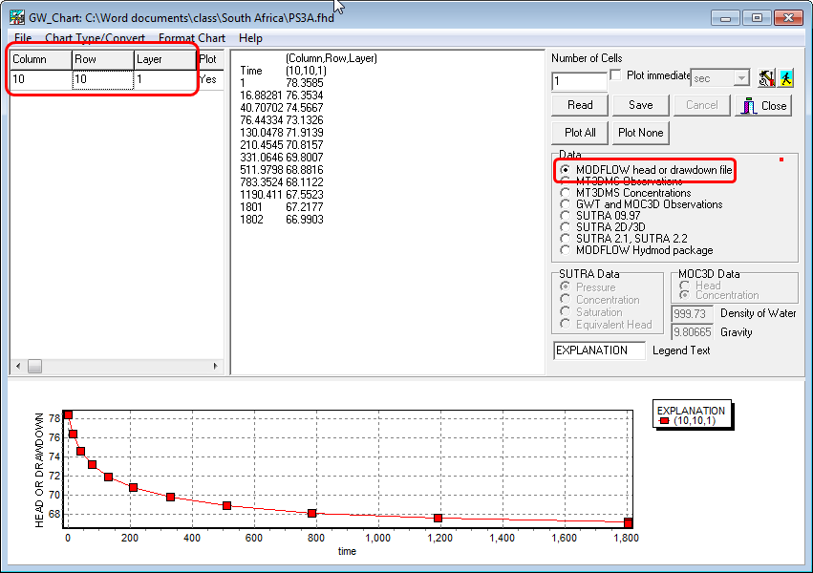
Plot Heads or Drawdown vs. Time

Slide 4
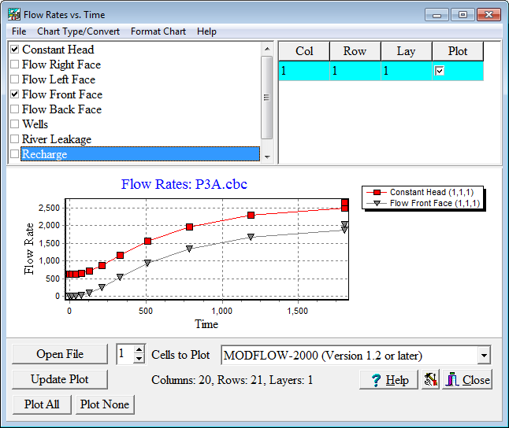
Plot Components of Flow in Individual Cells vs. Time

Slide 5
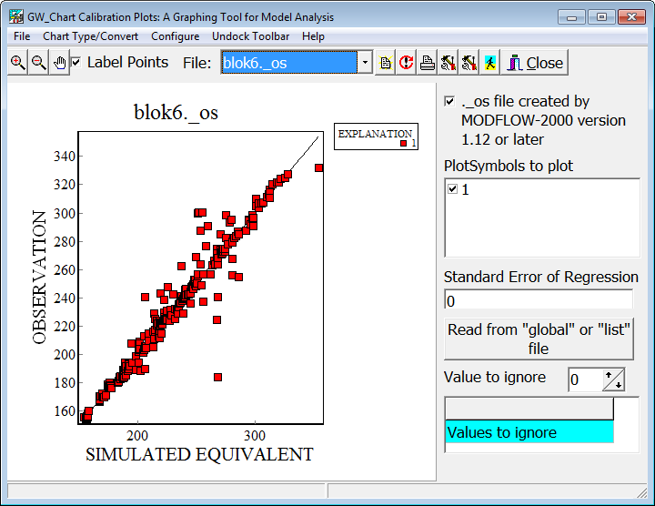
Calibration Plots

